Slide 1


Rogue Chess Team 15: Travis Head, Jose Herrera Sponsor: Prunav Dhulipala

Slide 2
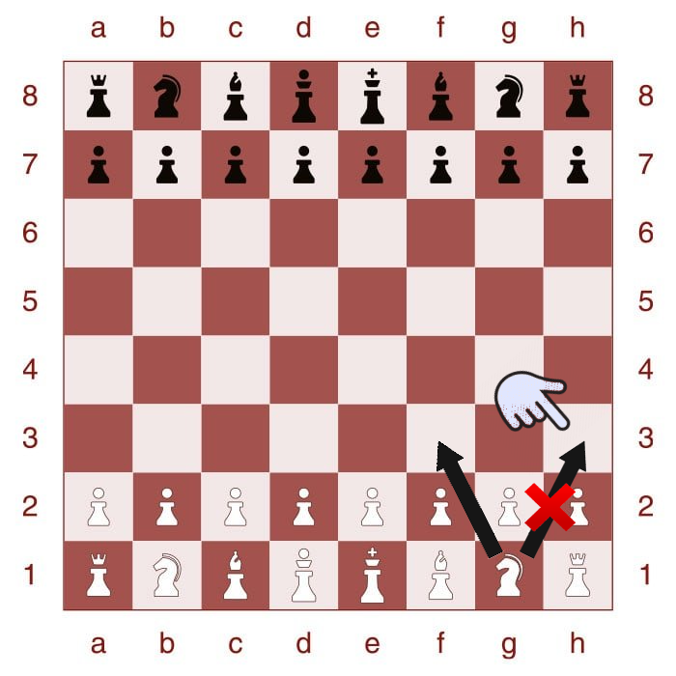
Problem Overview
Problem: Not that many people are exposed or know how to play the game of chess.
Proposed Solution: Develop an app of a new chess variation for Android product.
Develop an AI for Single Player Mode
Create a User Interface for the players interaction
Highlighted boxes to assist the player in making the next move legally
Create different difficulty levels
Upload the contents to the cloud

Slide 3
Problem Overview
Problem: Not that many people are exposed or know how to play the game of chess.
Proposed Solution: Develop an app of a new chess variation for Android product.
Develop an AI for Single Player Mode
Create a User Interface for the players interaction
Highlighted boxes to assist the player in making the next move legally
Create different difficulty levels
Upload the contents to the cloud

Slide 4
System Overview
Game Functionality (Jose)
Board
Move Chess Pieces
Legality of move
Artificial Intelligence (Travis)
User Interface (Jose)
Application
Neural Network
Main Menu
Settings
Android
Phone
Cloud

Slide 5
Game Functionality Subsystem
Game Functionality (Jose)
403 Deliverables
Title Menu
Setting Button
Home Button
Instructional Page
Chess Board
Chess Pieces (movement)
Highlights for the next move
Board
Move Chess Pieces
Legality of move
User Interface (Jose)
Application
Main Menu
Settings

Slide 6
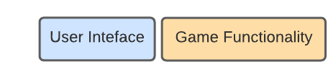
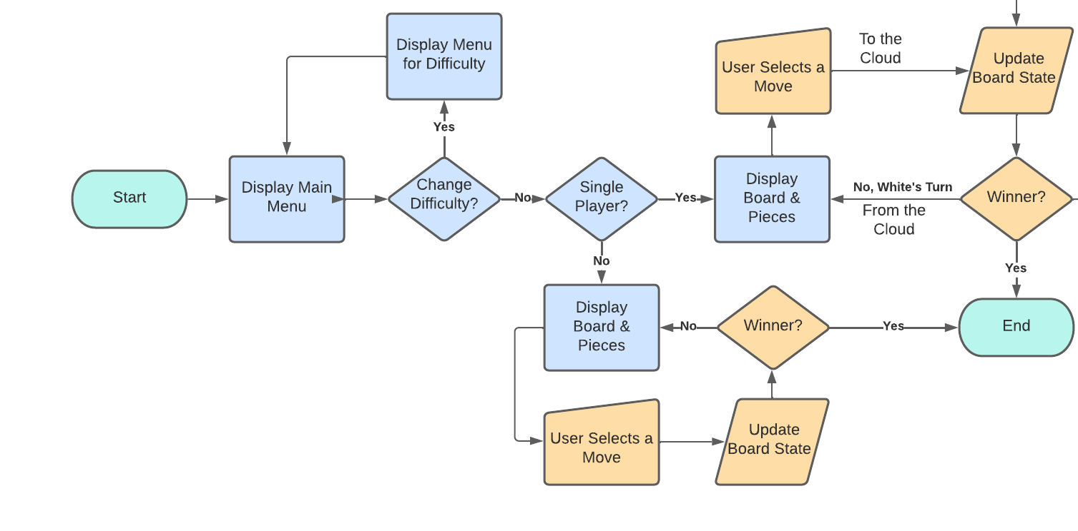
Game Functionality/User Interface Flowchart

Slide 7
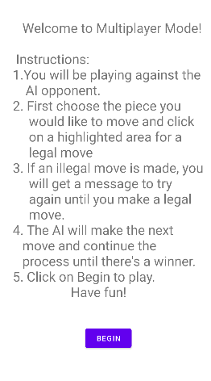
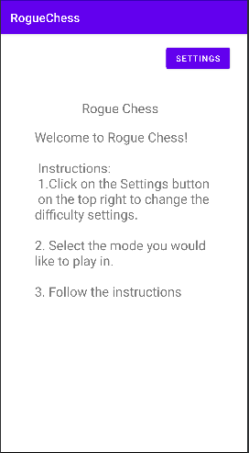
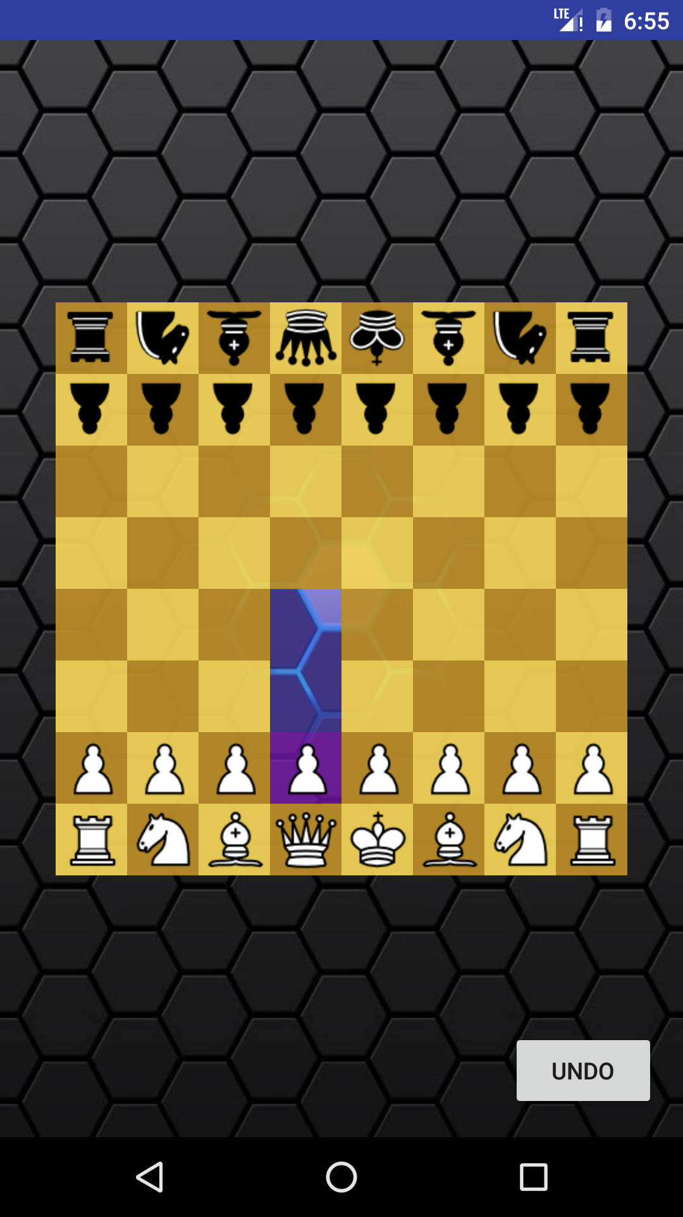
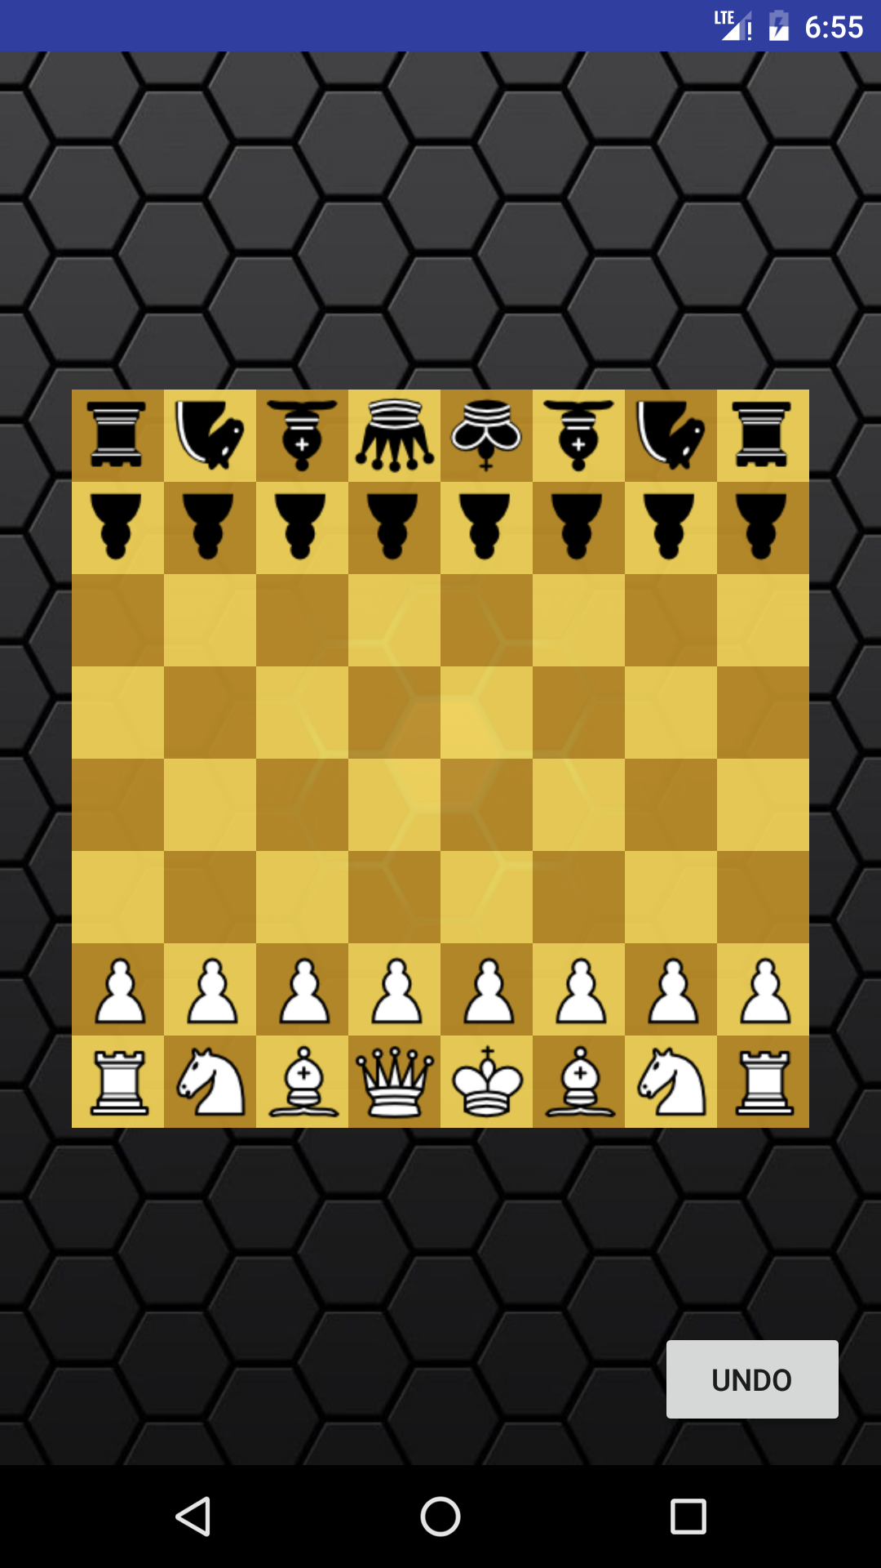
Game Functionality/User Interface Results

Slide 8
Artificial Intelligence Subsystem
403 Deliverables
Convolutional Neural Network
Recognize Board State and Pieces
Independent Piece Movement
Elo Rating of around 1300
Integration With Microsoft Azure
Neural network will reside on the Microsoft Azure servers for faster processing

Slide 9
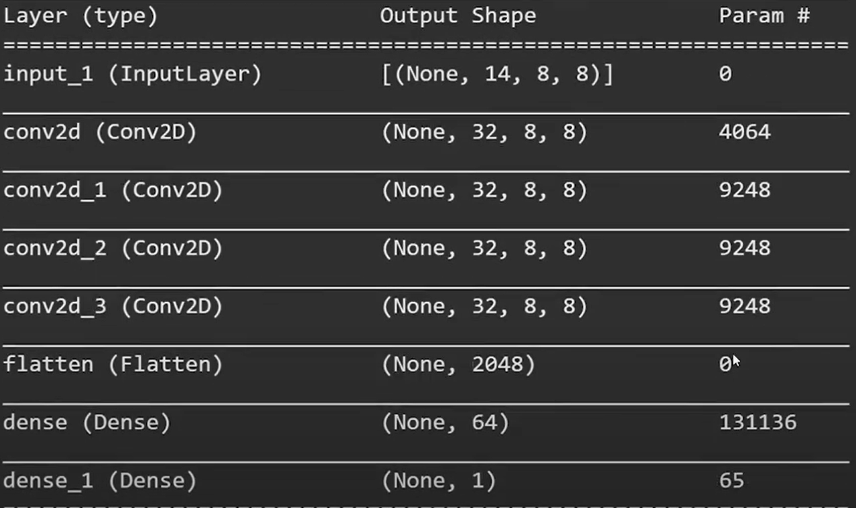
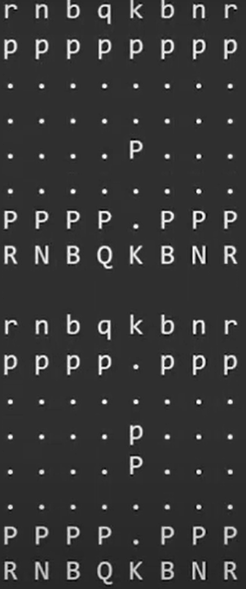
Artificial Intelligence Results

Slide 10
Execution plan
 | 2/14 | 2/21 | 2/28 | 3/7 | 3/14 | 3/21 | 3/28 | 4/4 | 4/11 | 4/18 | 4/25 | Date
System Update 1 |  |  |  |  |  |  |  |  |  |  |  | 2/15/22
Research |  |  |  |  |  |  |  |  |  |  | Completed | 2/22/22
Game Menu Appears |  |  |  |  |  |  |  |  |  |  | Behind Schedule | 2/23/22
Midterm Presentation |  |  |  |  |  |  |  |  |  |  | Not Started
Implement a Chess Board |  |  |  |  |  |  |  |  |  |  | In Progress
Functional AI
Functionality of Menus
System Update 2
Chess Piece Movement
AI Training
AI Rating
Final Design Presentation
Final System Demo
Final Report

Slide 11
Validation plan
Paragraph # | Test Name | Success Criteria | Methodology | Status | Responsible Engineer
8.2.2.1 | Data Size Requirements | Application is under 20Mb. | View file size and validate. | Untested | Jose
8.2.3.1 | Randomization Difficulty | 90%, 70%, or 50% obedience rate corresponding to Easy, Medium, Hard. | Record obedience successes on 100 moves from each setting. | Untested | Jose
8.2.3.2 | Chess Piece Movement | Each type of Piece moves only to respective ruleset. | Place each piece in the center/edge of an empty board and input a move to expected and unexpected valid tiles. | TESTED | Jose
8.2.3.4 | App Menu Functionality | Main Menu is visible, and each option is selectable. Selecting a game mode starts a match. Difficulty option opens a new menu that saves selected setting. | Open the application and validate main menu is visible. Select each option on the menu. | TESTED | Jose
8.2.1.5 | App Graphics | Menus, board, pieces, and highlighted tiles are all visible when needed. | Open the application and validate visibility. Start a match in each mode and select/deselect pieces. | TESTED | Jose
8.2.1.6 | Artificial Intelligence Rating | Elo Rating of at least 1300. | Run the AI against another chess program for 10 matches at ratings of 900, 1100, 1200, 1300, 1400, and 1500. | Untested | Travis
8.2.1.7 | Artificial Intelligence Movement | Artificial Intelligence can input a valid move on its turn. | Input a board state and run the AI with a written output. | TESTED | Travis

Slide 12
Remaining Tasks
403 Deliverables
The Probability of the Disobedience needs to be implemented (Sub 1)
Create the different difficulty modes (Sub 1)
Test Elo Rating (Sub 2)
404 Deliverables
Implement the AI for single player mode
Ensure AI can make a move in 2 seconds or less
Make sure the Application is 20MB or below
Upload the Application to the cloud for user use

Slide 13
Questions?

